Slide 1

OpenBook

Slide 2


Clients

Slide 3


Clients
Agencies

Slide 4


Clients
Talents
Agencies
OpenBook

Slide 5
Communication

Slide 6
Communication
Scheduling

Slide 7
Communication
Scheduling
Finance

Slide 8

A solution on
ONE
platform

Slide 9
DEMO

Slide 10

DEMO

Slide 11
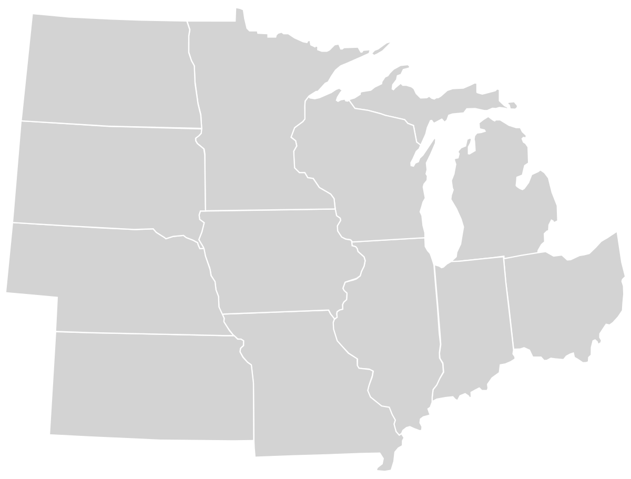

Slide 13
15+
Agencies

Slide 14
$900 / booking
15+
Agencies

Slide 15
$900 / booking
15+
Agencies
$22.5M
annual revenue

Slide 16

Is the industry overall inconsistent?
90.3%
Yes
Notes:
Comps

Slide 17
Revenue
Notes:
Comps

Slide 18
Revenue
$466k annual
2%
Trans. Fee
$90* m/r
Notes:
Comps

Slide 19
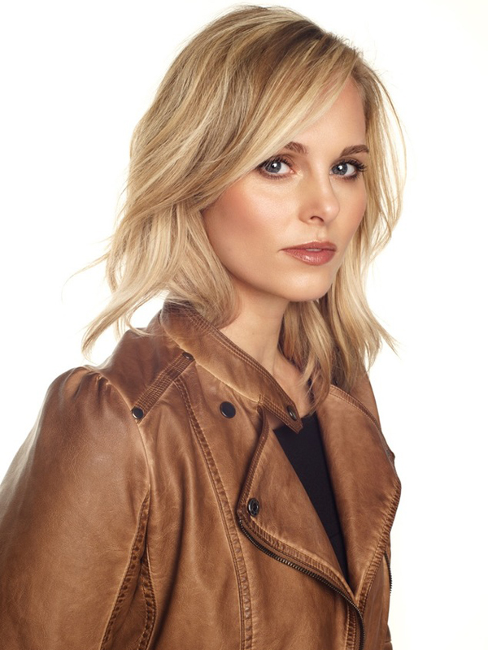
“It would be so helpful to run the agency with a better software- I am so excited to use OpenBook.”
Heather Hattaway
*Found Model Management Founder
& our Agent

Slide 20
“I just need some modeling work, and I need to be paid for it.” - Sierra
“So many agencies are not paying!!!!!!!!!” - Olivia
“It would be so helpful to run the agency with a better software- I am so excited to use OpenBook.”
Heather Hattaway
*Found Model Management Founder
& our Agent
“Really cool! Excited to learn more!” - Lexi
“I respect the desire and need for regulation, and it has to start somewhere” - Erika
“OpenBook is about putting the power back into the hands of models, especially with finances.” - Gail

Slide 21
Thank y u for your time!

Slide 22
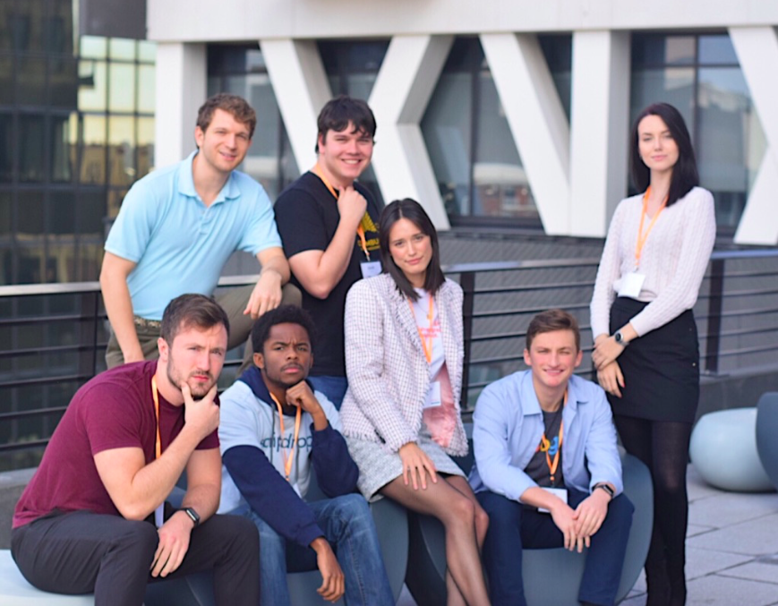
The people behind OpenBook

Slide 23



Competition
“A Dynamic Talent and Model Management Platform brought to you by Casting Networks”
“Work smarter...not harder”
“Work smoothly”
Notes:
Next Steps - Scaling

Slide 24


Survey
Have you had booking/scheduling issues?
74.2%
Yes
77.4%
Yes
Do you usually know when you are receiving payment for jobs?
Notes:
Next Steps - Scaling

Slide 25
$1.5M
avg annual rev / agency
15+
Agencies

